Slide 1
Break-Even Analysis
An Equilibrium Point

Slide 2
Break-Even Analysis
Break-even analysis entails calculating and examining the margin of safety for an entity based on the revenues collected and associated costs. In other words, the analysis shows how many sales it takes to pay for the cost of doing business.
The analysis is also known as cost analysis. Break even analysis is concerned with finding the point at which revenue and costs are exactly equal.
The point is called Break Even Point.
This is a volume of output at which a business neither earns a profit nor incurs a loss.
The analysis focuses on the relationship between fixed cost, variable cost and selling price.
We can calculate break even point as:
$$Break−Even Point(BEP)= \frac{Fixed Cost (FC)}{Selling price per unit \left(SP\right)−Variable Cost(VC)}$$

Slide 3
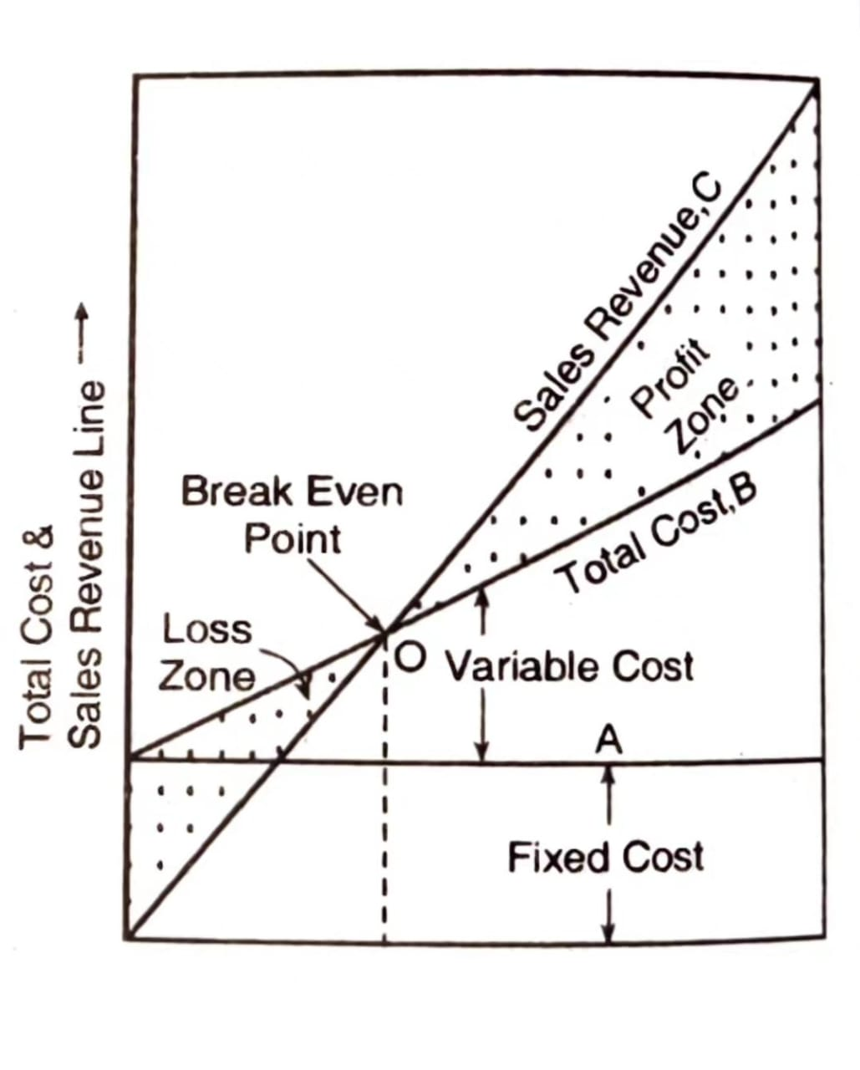
Break-Even Analysis
When production exceeds the “Break-even point,” the business makes a profit and when it is below the “Break-even point,” the business makes loss. The same is shown in the graph.
A break even chart is a graphical representation of the relationship costs & revenue at a given time, and determines the break even point and profit potential under varying conditions of output and cost.

Slide 4
Break-Even Analysis
Thank you

